Slide 1

Predefined and User-Defined Functions

Slide 2
Introduction
Functions are like building blocks
They allow complicated programs to be divided into manageable pieces
Some advantages of functions:
A programmer can focus on just that part of the program and construct it, debug it, and perfect it
Different people can work on different functions simultaneously
Can be re-used (even in different programs)
Enhance program readability

Slide 3
Introduction
Functions
Called modules
Like miniature programs
Can be put together to form a larger program

Slide 4
Predefined Functions
In algebra, a function is defined as a rule or correspondence between values, called the function’s arguments, and the unique value of the function associated with the arguments
If f(x) = 2x + 5, then f(1) = 7, f(2) = 9, and f(3) = 11
1, 2, and 3 are arguments
7, 9, and 11 are the corresponding values

Slide 5
Predefined Functions
Some of the predefined mathematical functions are:
sqrt(25)
pow(x, y)
floor(5)
Predefined functions are organized into separate libraries
I/O functions are in iostream header
Math functions are in cmath header

Slide 6
Predefined Functions
pow(x,y) calculates x^{y}
pow(2, 3) = 8.0
Returns a value of type double
x and y are the parameters (or arguments)
The function has two parameters
sqrt(x) calculates the nonnegative square root of x, for x >= 0.0
sqrt(2.25) is 1.5
Type double

Slide 7
Predefined Functions
The floor function floor(x) calculates largest whole number not greater than x
floor(48.79) is 48.0
Type double
Has only one parameter

Slide 8
Predefined Functions

Slide 9
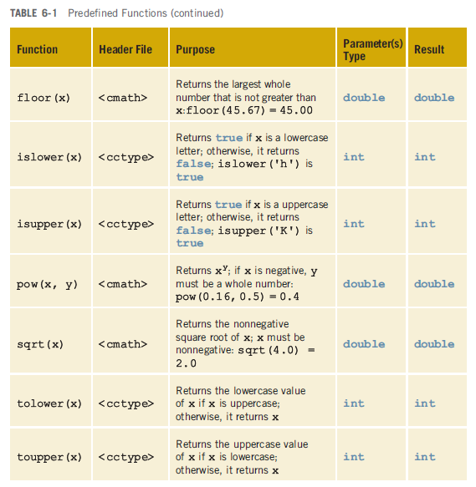
Predefined Functions

Slide 10
User-Defined Functions
Value-returning functions: have a return type
Return a value of a specific data type using the return statement
Void functions: do not have a return type
Do not use a return statement to return a value

Slide 11
Value-Returning Functions
To use these functions you must:
Include the appropriate header file in your program using the include statement
Know the following items:
Name of the function
Number of parameters, if any
Data type of each parameter
Data type of the value returned: called the type of the function

Slide 12
Value-Returning Functions
Because the value returned by a value-returning function is unique, must:
Save the value for further calculation
Use the value in some calculation
Print the value
A value-returning function is used in an assignment or in an output statement
One more thing is associated with functions:
The code required to accomplish the task

Slide 13
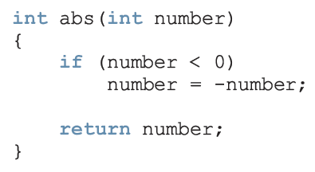
Value-Returning Functions

Slide 14
Value-Returning Functions
Heading: first four properties above
Example: int abs(int number)
Formal Parameter: variable declared in the heading
Example: number
Actual Parameter: variable or expression listed in a call to a function
Example: x = pow(u, v)

Slide 15
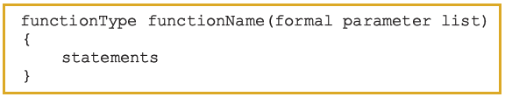
Syntax: Value-Returning Function
Syntax:
functionType is also called the data type or return type

Slide 16
Syntax: Formal Parameter List

Slide 17
Function Call

Slide 18
Syntax: Actual Parameter List
The syntax of the actual parameter list is:
Formal parameter list can be empty:
A call to a value-returning function with an empty formal parameter list is:

Slide 19
return Statement
Once a value-returning function computes the value, the function returns this value via the return statement
It passes this value outside the function via the return statement

Slide 20
Syntax: return Statement
The return statement has the following syntax:
In C++, return is a reserved word
When a return statement executes
Function immediately terminates
Control goes back to the caller
When a return statement executes in the function main, the program terminates

Slide 21
Function Prototype
Function prototype: function heading without the body of the function
Syntax:
It is not necessary to specify the variable name in the parameter list
The data type of each parameter must be specified

Slide 22
Flow of Execution
Execution always begins at the first statement in the function main
Other functions are executed only when they are called
Function prototypes appear before any function definition
The compiler translates these first
The compiler can then correctly translate a function call

Slide 23
Flow of Execution
A function call results in transfer of control to the first statement in the body of the called function
After the last statement of a function is executed, control is passed back to the point immediately following the function call
A value-returning function returns a value
After executing the function the returned value replaces the function call statement

Slide 24
Void Functions
Void functions and value-returning functions have similar structures
Both have a heading part and a statement part
User-defined void functions can be placed either before or after the function main
If user-defined void functions are placed after the function main
The function prototype must be placed before the function main

Slide 25
Void Functions
A void function does not have a return type
return statement without any value is typically used to exit the function early
Formal parameters are optional
A call to a void function is a stand-alone statement

Slide 26

Void Functions
Function definition syntax:
Formal parameter list syntax:

Slide 27

Void Functions (cont'd.)
Function call syntax:
Actual parameter list syntax:

Slide 28
Void Functions
Value parameter: a formal parameter that receives a copy of the content of corresponding actual parameter
Reference parameter: a formal parameter that receives the location (memory address) of the corresponding actual parameter

Slide 29
Value Parameters
If a formal parameter is a value parameter
The value of the corresponding actual parameter is copied into it
The value parameter has its own copy of the data
During program execution
The value parameter manipulates the data stored in its own memory space

Slide 30
Reference Variables as Parameters
If a formal parameter is a reference parameter
It receives the memory address of the corresponding actual parameter
A reference parameter stores the address of the corresponding actual parameter
During program execution to manipulate data
The address stored in the reference parameter directs it to the memory space of the corresponding actual parameter

Slide 31
Reference Variables as Parameters
Reference parameters can:
Pass one or more values from a function
Change the value of the actual parameter
Reference parameters are useful in three situations:
Returning more than one value
Changing the actual parameter
When passing the address would save memory space and time

Slide 32
Value and Reference Parameters and Memory Allocation
When a function is called
Memory for its formal parameters and variables declared in the body of the function (called local variables) is allocated in the function data area
In the case of a value parameter
The value of the actual parameter is copied into the memory cell of its corresponding formal parameter

Slide 33
Value and Reference Parameters and Memory Allocation
In the case of a reference parameter
The address of the actual parameter passes to the formal parameter
Content of formal parameter is an address
During execution, changes made by the formal parameter permanently change the value of the actual parameter
Stream variables (e.g., ifstream) should be passed by reference to a function

Slide 34
Reference Parameters and Value-Returning Functions
You can also use reference parameters in a value-returning function
Not recommended
By definition, a value-returning function returns a single value
This value is returned via the return statement
If a function needs to return more than one value, you should change it to a void function and use the appropriate reference parameters to return the values

Slide 35
Scope of an Identifier
The scope of an identifier refers to where in the program an identifier is accessible
Local identifier: identifiers declared within a function (or block)
Global identifier: identifiers declared outside of every function definition
C++ does not allow nested functions
The definition of one function cannot be included in the body of another function

Slide 36
Global Variables, Named Constants, and Side Effects
Using global variables causes side effects
A function that uses global variables is not independent
If more than one function uses the same global variable and something goes wrong
It is difficult to find what went wrong and where
Problems caused in one area of the program may appear to be from another area
Global named constants have no side effects

Slide 37
Function Overloading: An Introduction
In a C++ program, several functions can have the same name
This is called function overloading or overloading a function name

Slide 38
Function Overloading
Two functions are said to have different formal parameter lists if both functions have:
A different number of formal parameters, or
If the number of formal parameters is the same, then the data type of the formal parameters, in the order you list them, must differ in at least one position

Slide 39
Function Overloading
The following functions all have different formal parameter lists:
The following functions have the same formal parameter list:

Slide 40
Function Overloading
Function overloading: creating several functions with the same name
The signature of a function consists of the function name and its formal parameter list
Two functions have different signatures if they have either different names or different formal parameter lists
Note that the signature of a function does not include the return type of the function

Slide 41
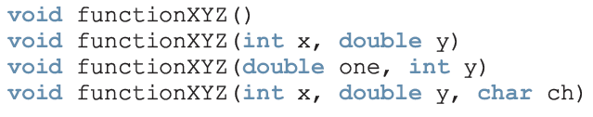

Function Overloading
Correct function overloading:
Syntax error:

Slide 42
Functions with Default Parameters
In a function call, the number of actual and formal parameters must be the same
C++ relaxes this condition for functions with default parameters
You specify the value of a default parameter when the function name appears for the first time (e.g., in the prototype)
If you do not specify the value of a default parameter, the default value is used

Slide 43
Functions with Default Parameters
All default parameters must be the rightmost parameters of the function
In a function call where the function has more than one default parameter and a value to a default parameter is not specified:
You must omit all of the arguments to its right
Default values can be constants, global variables, or function calls
However, you cannot assign a constant value as a default value to a reference parameter

Slide 44


